Slide 1


COMP 4475
Topics Artificial Intelligence
Project 2: ML in Julia-Natural Language Processing
-Rakshit Saxena
0905094

Slide 2

Overview
Hello Guys, I am Rakshit Saxena and I have made a project on Machine Learning in Julia.
Julia is a high-level dynamic programming language (with statically-typed features too). It is used for computational science like machine learning, computational linguistics, artificial intelligence, data visualization, data science.
My project is based on Word Embedding in Julia.
I have used TextAnalysis.jl for NaiveBayesClassifier model for sentiment analysis for corpus of IMDB reviews.

Slide 3

Packages used
So, for word vectors i have used Embeddings.jl. From Embeddings i get pre trained word embeddings for about 3 million words in the english language.
For cosine formula, I have used Distances.jl.
For plotting graphs I have used Plots.jl.
I have also used wordtokenizers and text analysis, Corpus loaders for sentiment analysis for IMDB reviews

Slide 4
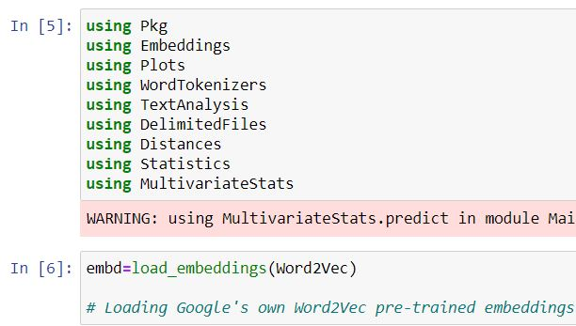
Importing Packages
And loading the Google Word2Vec pre trained embeddings

Slide 5
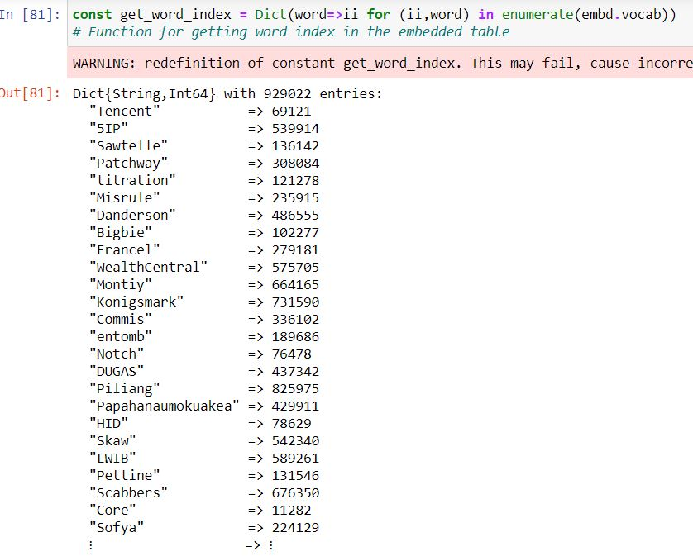
Then I make a function to get the index of words in the Embeddings table

Slide 6
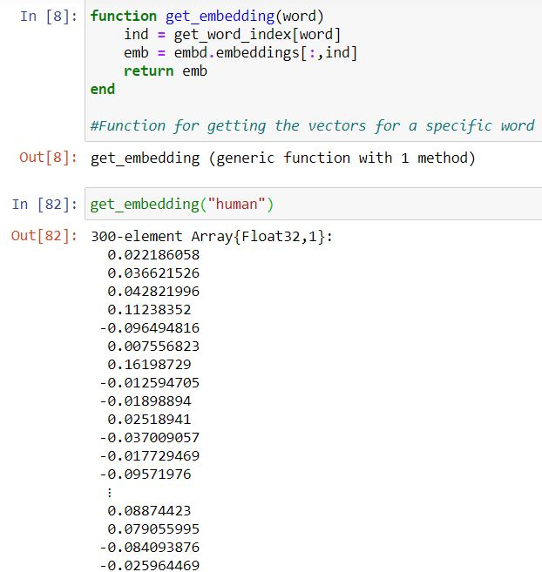
Function for getting the embeddings (vectors) for a specific word, it is a 300 element array with possibly 300 vectors
Our embeddings table is divided into an array of Vocab (which contains words) and embeddings(about 300 embeddings for each words)

Slide 7
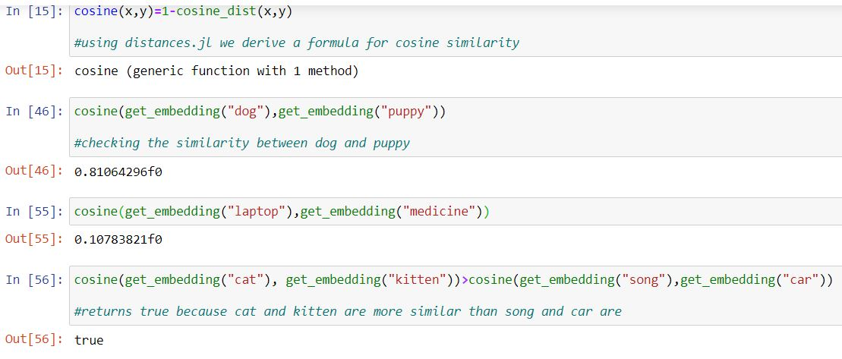
Using Distances.jl i made a formula for calculating the cosine values between two different word vectors, this will further help us with similarity analysis between words

Slide 8
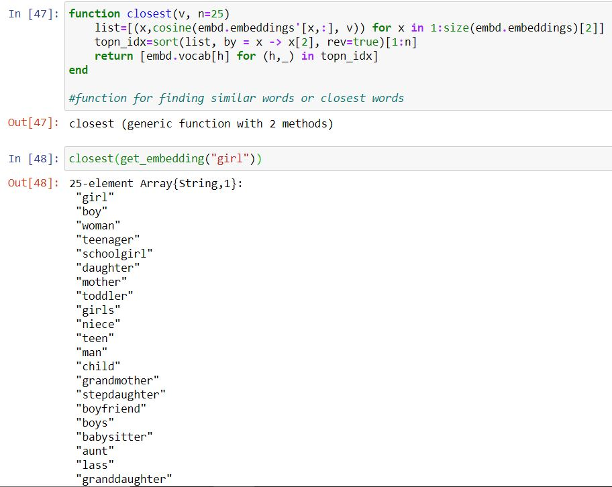
Now, I have developed a function called Closest which returns a 25 element array of strings, it uses the cosine formula for calculating the closest words in regards to the word we have entered

Slide 9
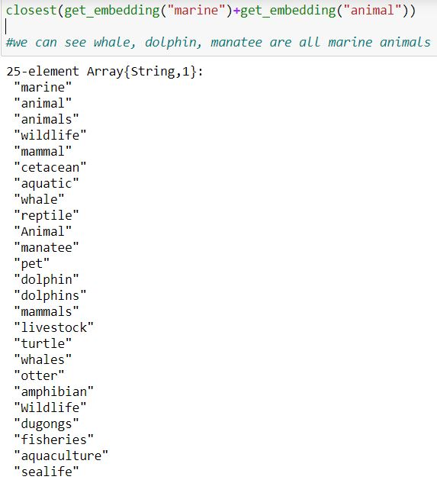
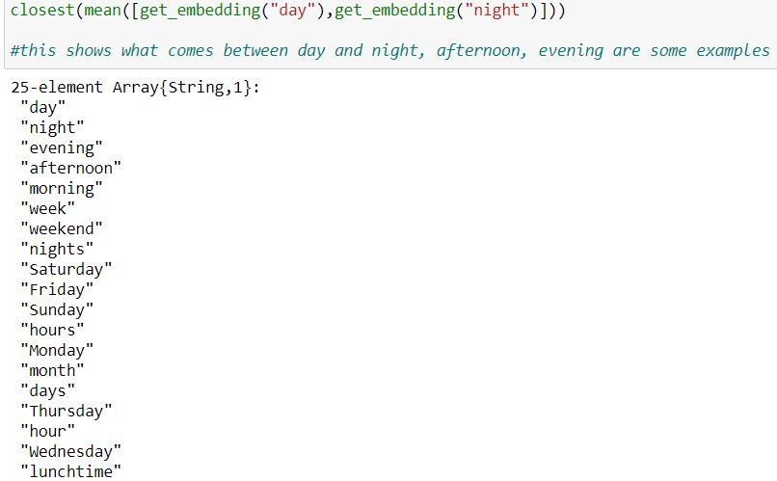

Slide 10
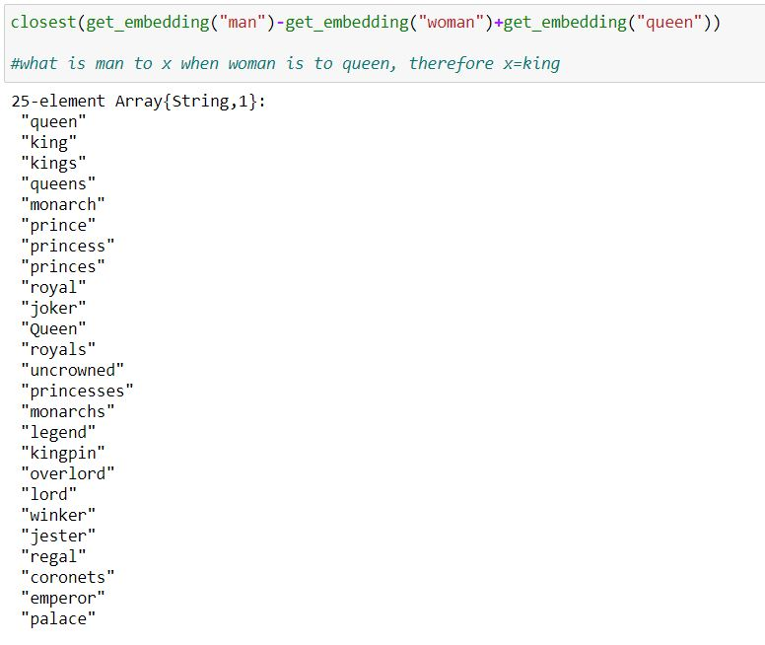
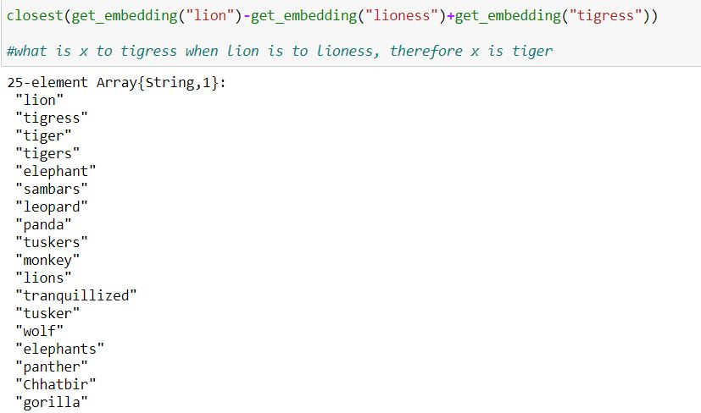

Slide 11
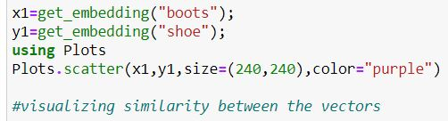
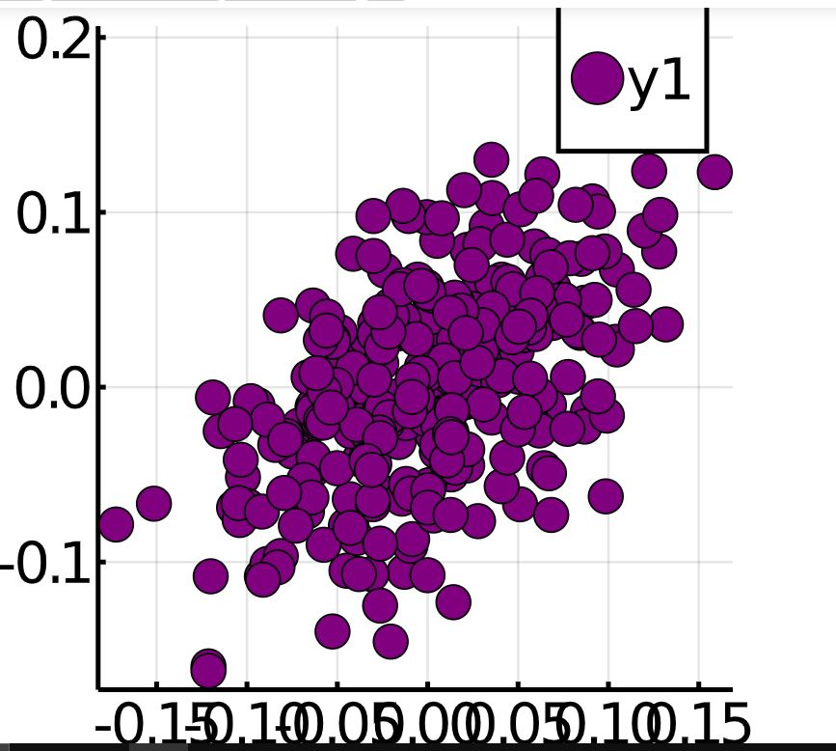
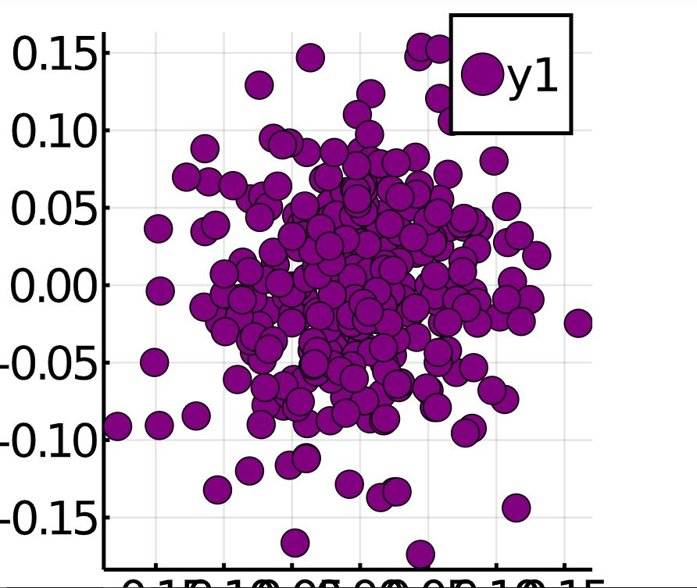
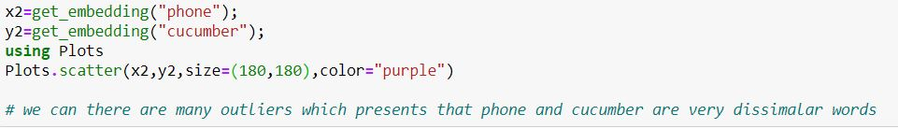

Slide 12
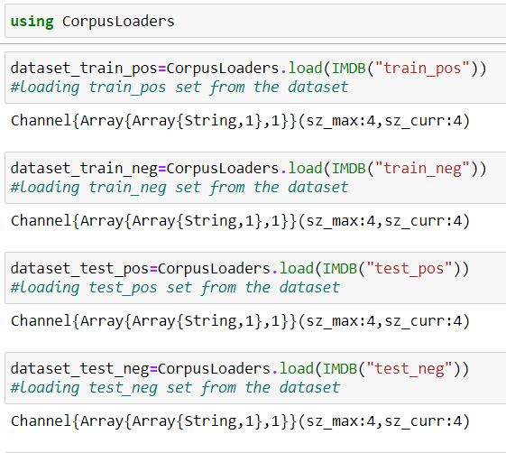
Using CorpusLoaders.jl
I have downloaded IMDB reviews which contain positive and negative reviews about movies. More than 50000 reviews are there.

Slide 13
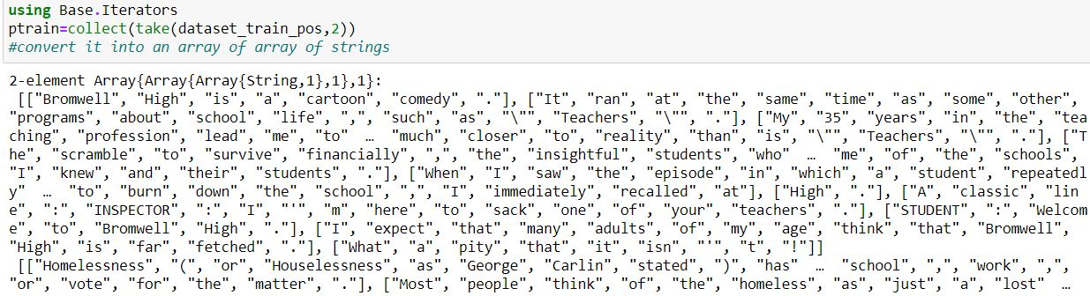
Now we convert the document into an array of array of strings, similarly we do it for both negative and positive and train and test models

Slide 14
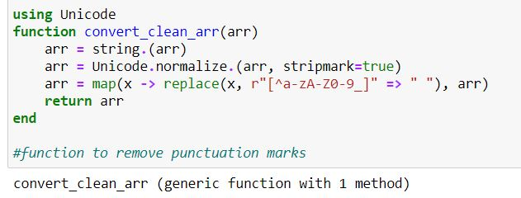
Now I use, unicode.jl and make a function to remove unnecessary punctuation marks in the corpus

Slide 15
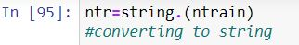
We then convert it into the strings so that i can feed it to the convert_clean_arr function to remove the punctuation marks

Slide 16
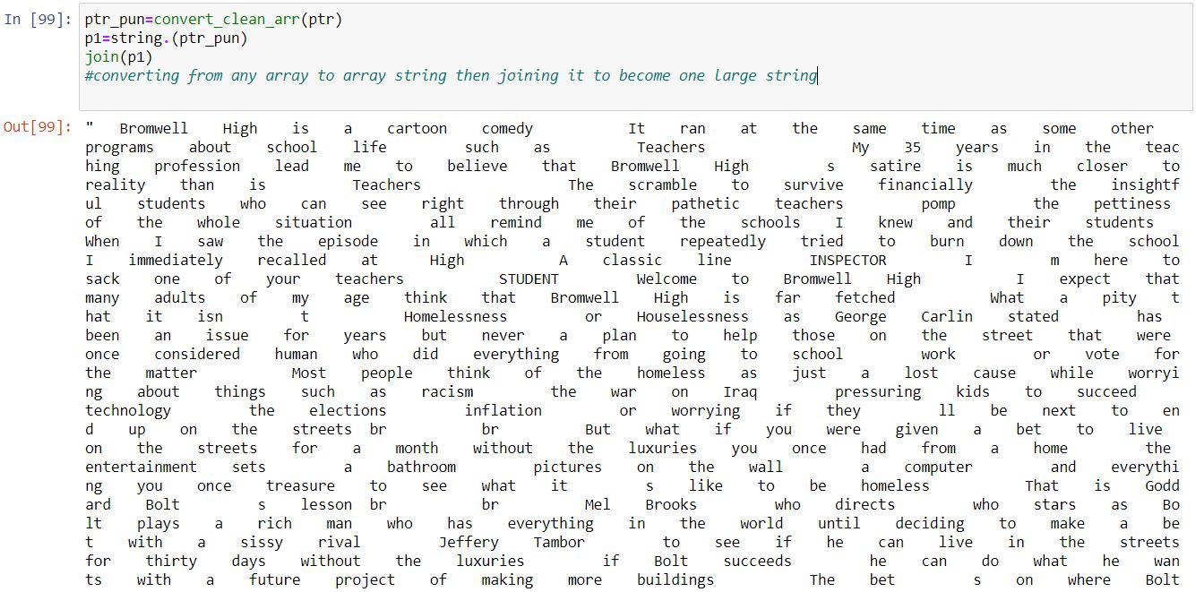
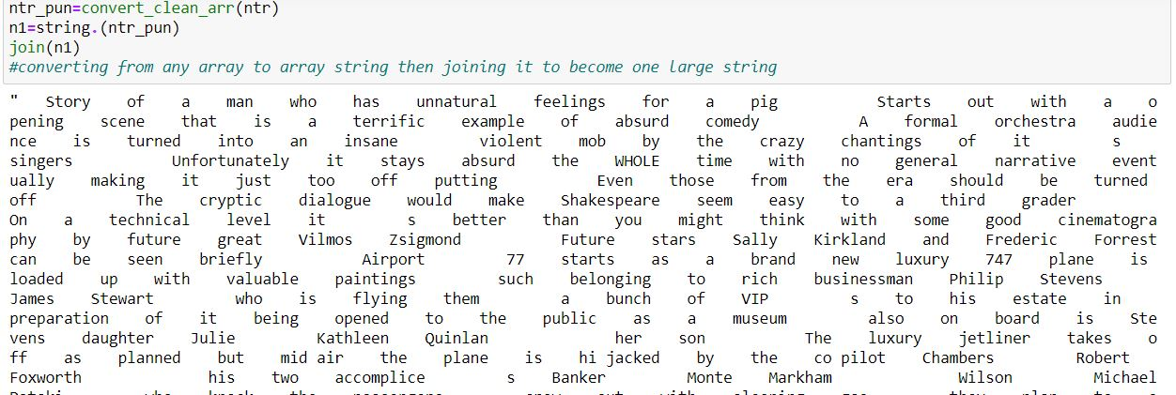
Now to feed it to the model for sentiment analysis using Naive Bayes Classifier I have to convert it back to array of strings and then join all the strings as one large string

Slide 17
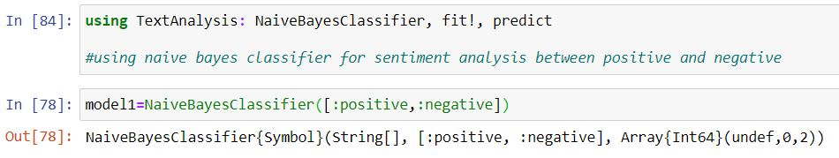
Using TextAnalysis.jl I import Naive Bayes Classifier, fit! And predict.
Now there are two classifiers for our analysis i.e. Positive and Negative

Slide 18
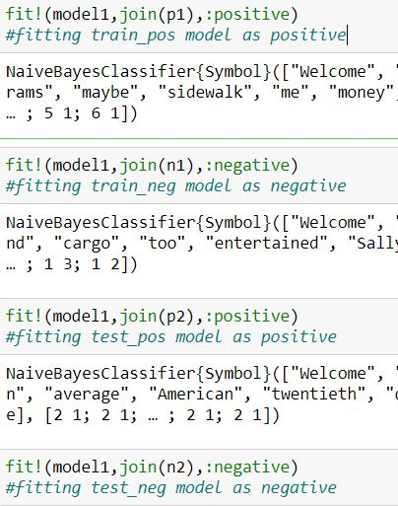
Now, I fit the model in the classifier. By using fit!, I fit train_pos, train_neg, test_pos, test_neg models for analysis.

Slide 19
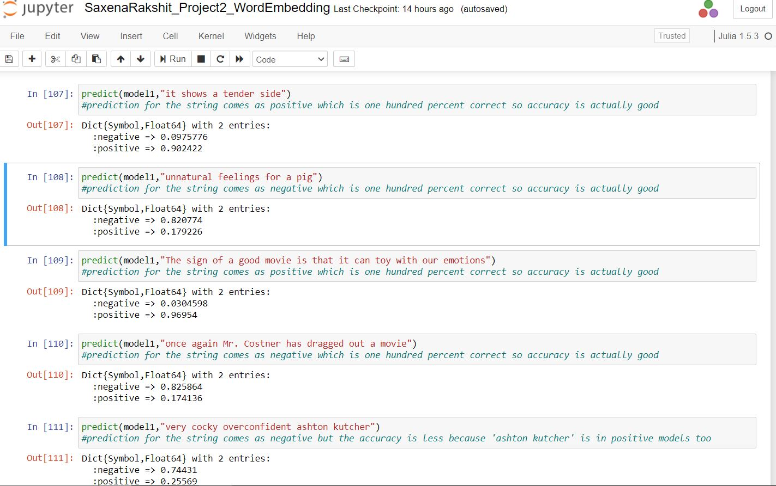
Predictions:

Slide 20


Thank You.
-Rakshit Saxena

